Slide 1

2017 Top Trends in Innovative Technologies for Higher Education
Presented by:
Marcos A. Nunez
2017 Board Member
Technology Commission
Association of Florida Colleges

Slide 2
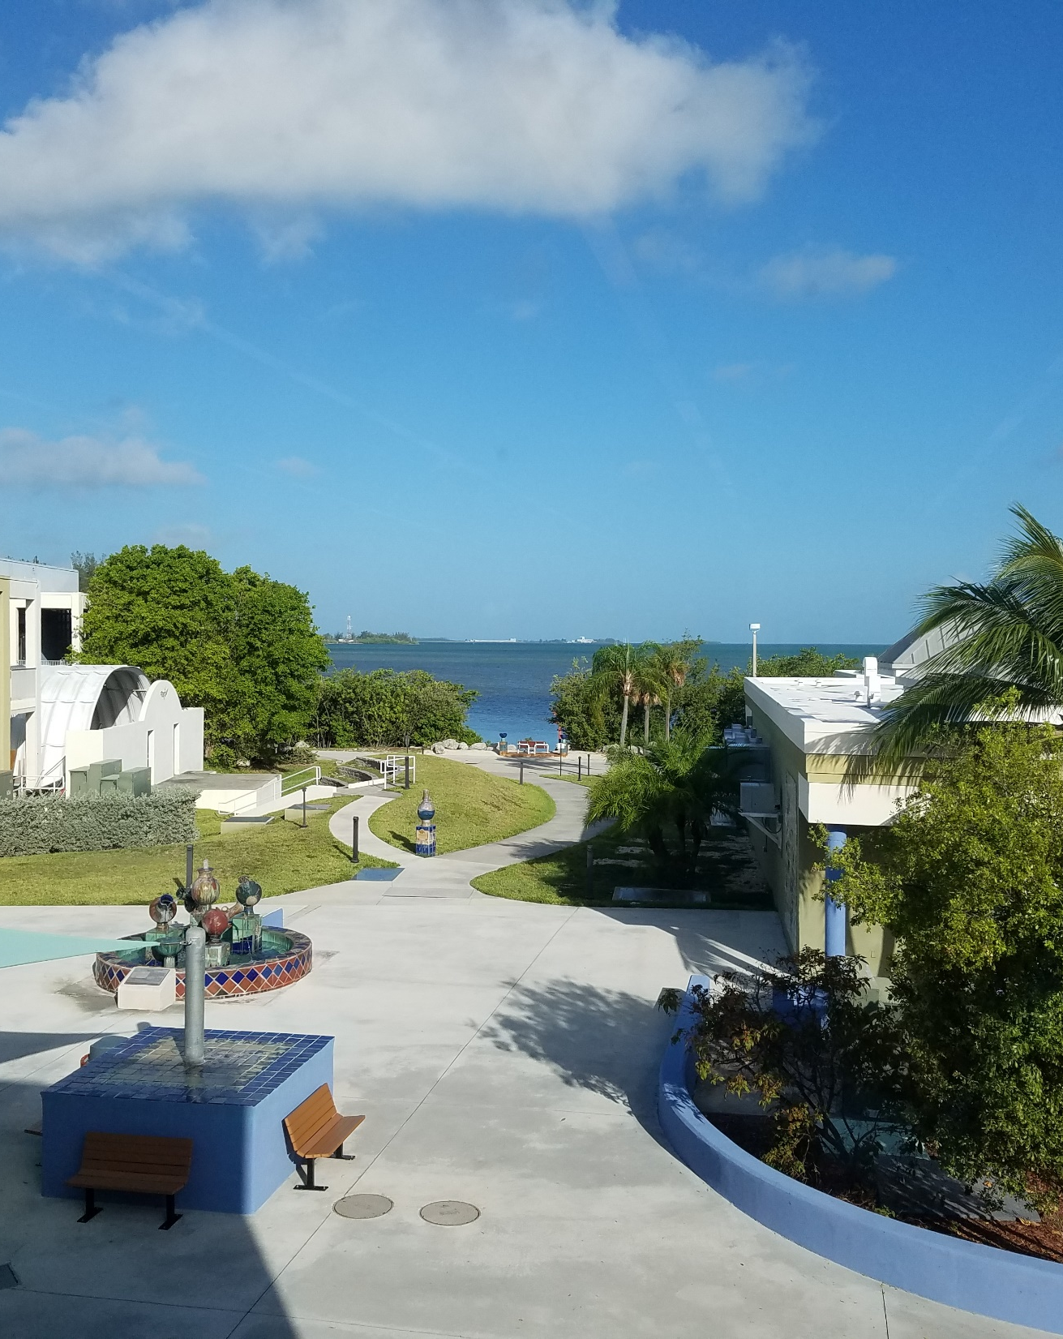
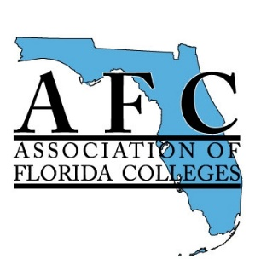
Presented at:
Region V & Administration Commission
2017 Joint Spring Conference
Florida Keys Community College
Key West, Florida
May 2017
© 2017, Technology Commission, Association of Florida Colleges.
Permission is granted to copy, distribute, or transmit this material in any format; provided that proper attribution is included.

Slide 3


Introduction
The NMC Horizon Report: 2017 Higher Education Edition.
The New Media Consortium (NMC).
The EDUCAUSE Learning Initiative.
Five-year impact of innovative practices and technologies for higher education.
Notes:
NMC is an international community of experts in educational technology. ELI is a collaborative community dedicated to all aspects of technology in higher education and committed to advancing learning through innovation. Technology Adoption and Educational Change steered the discussions of the experts

Slide 4
Going back in time … 2004 trends
Learning Objects
Assemblies of audio, graphic, animation, and other digital formats that are intended to be reusable in a variety of ways and easily combined into higher-level instructional components such as lessons and modules.
Physics Animation (2004)

Slide 5
Going back in time … 2004 trends
Knowledge Webs
Group of convergent technologies and ideas based on a dynamic concept of individual and group knowledge generation and sharing
James Burke's Knowledge Web

Slide 6
Going back in time … 2010 trends
Electronic Books
“… electronic books are gaining a foothold on campuses as well, where they serve as a cost-effective and portable alternative to heavy textbooks …”

Slide 7
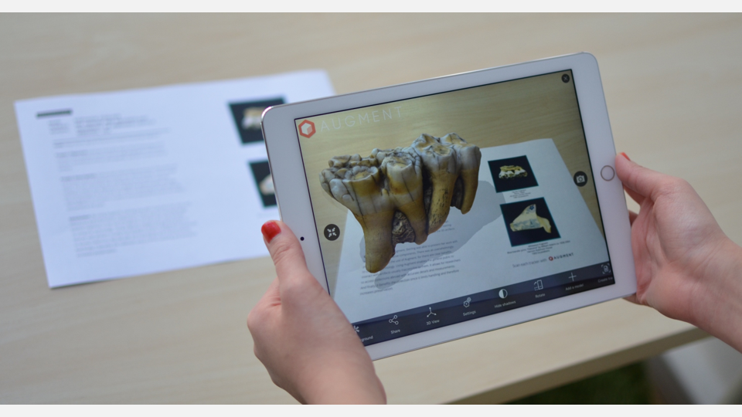

Going back in time … 2010 trends
Augmented Reality (AR)
Blending digital information with our sensory perception of the real world, for the purpose of enhancing the (learning) experience

Slide 8
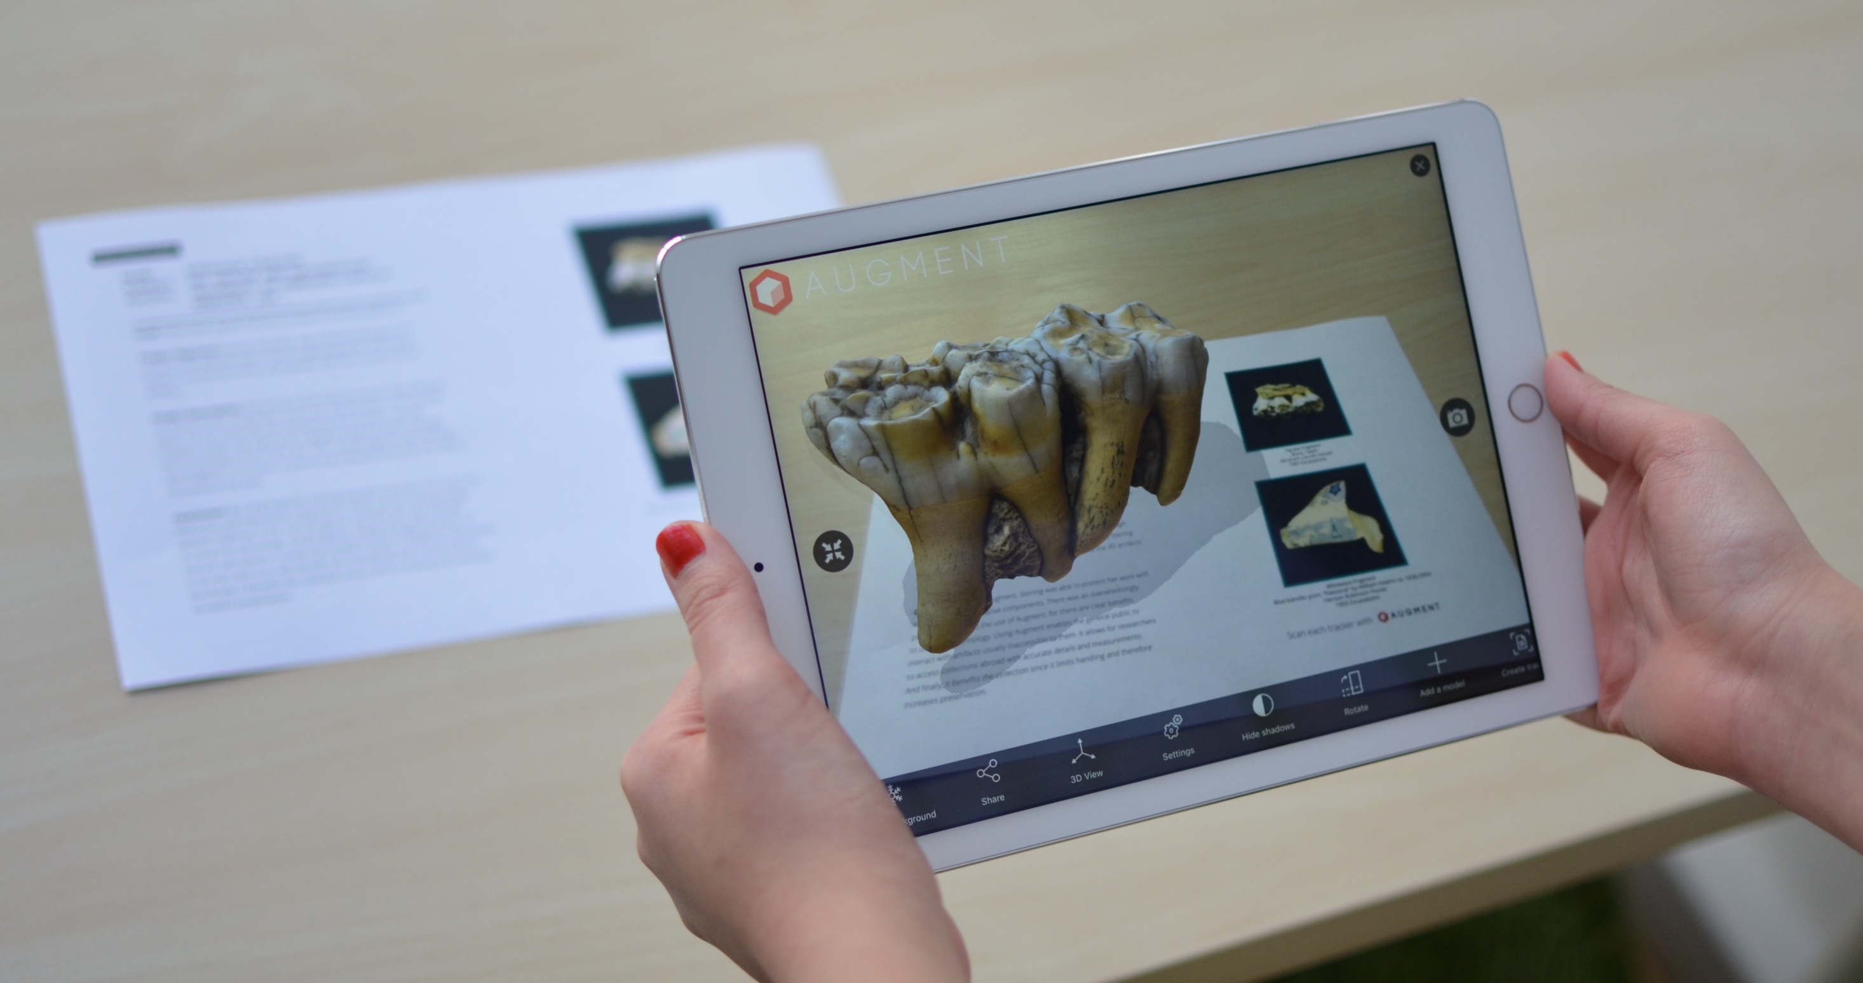

Slide 9
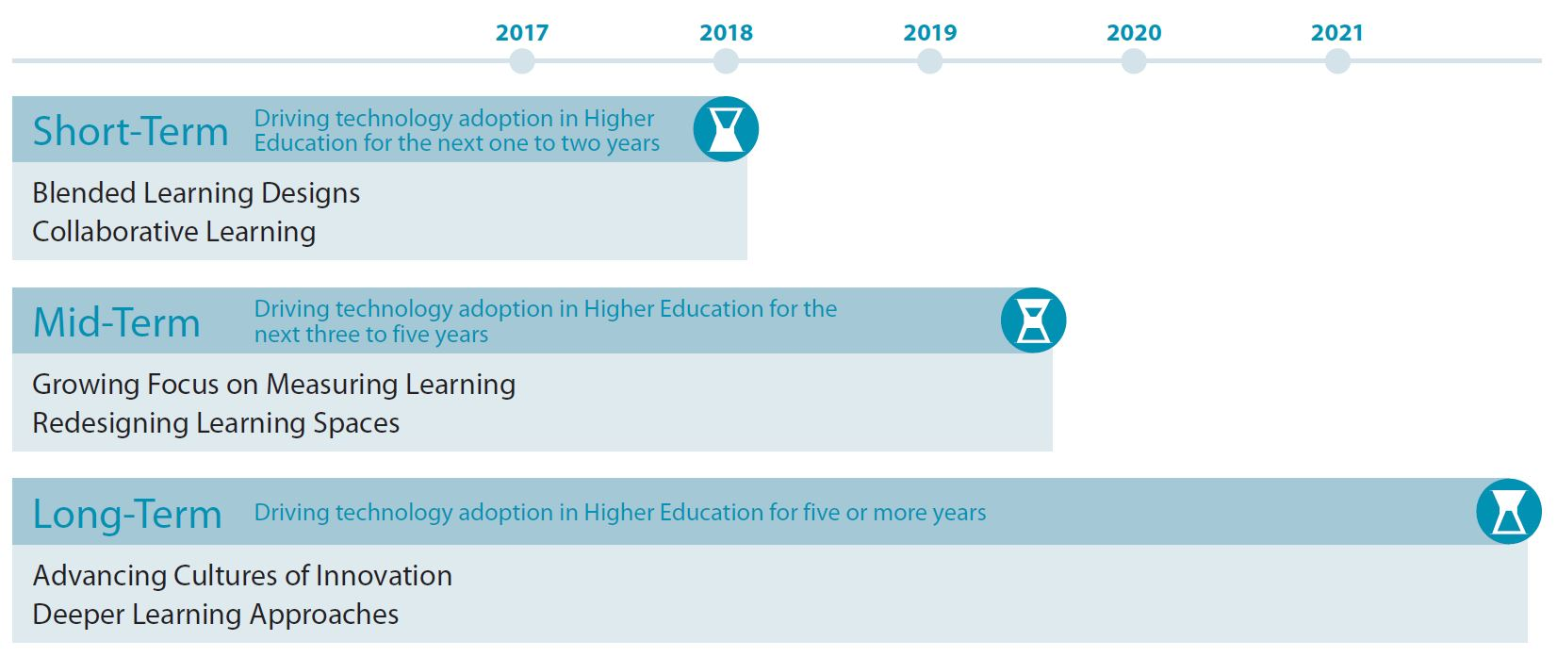
Today … 2017 Top Trends

Slide 10
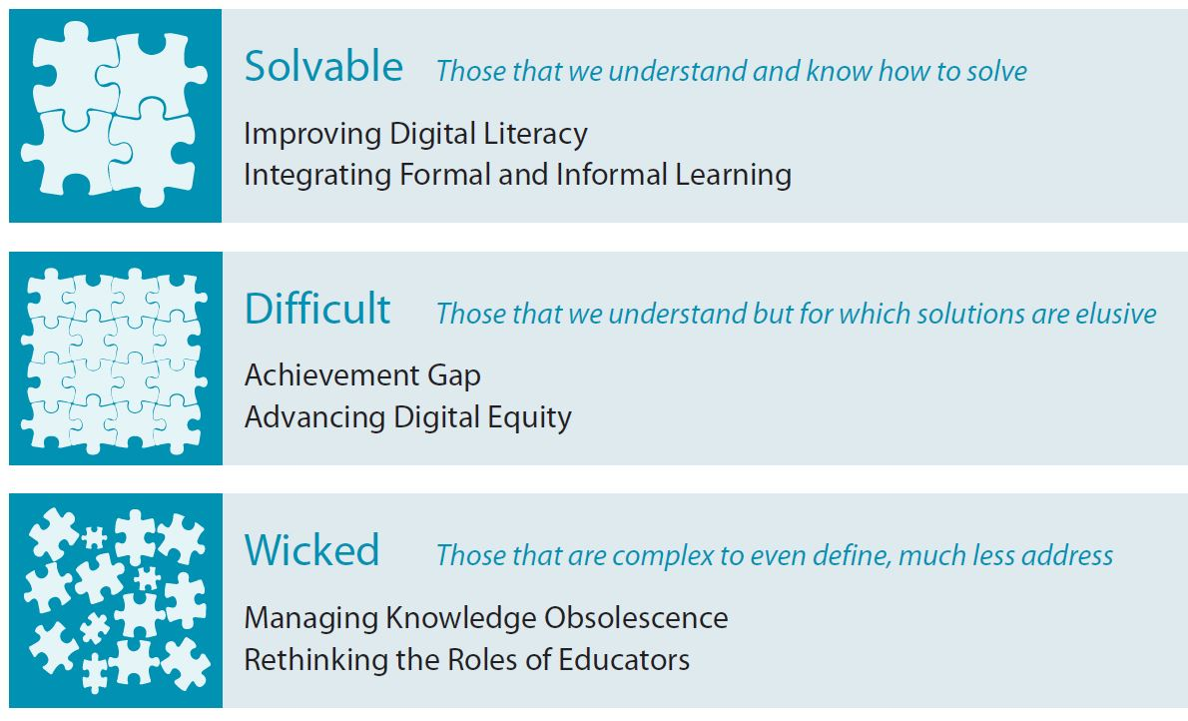
Today … Significant Challenges

Slide 11
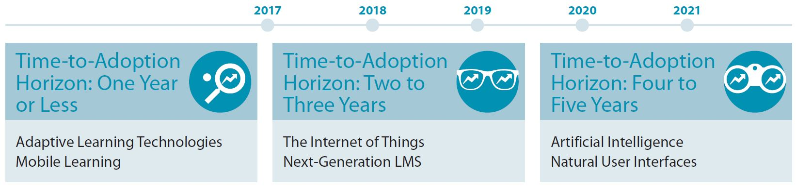
Today … Important Developments

Slide 12
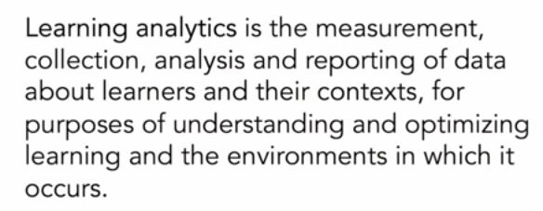
Learning Analytics
Mid-Term Trend: Three to five years

Slide 13
Learning Analytics - Insights
An interest rather than a priority at most institutions.
Most common objectives: retention, course-level academic success, and reduced time to degree.
More commonly used to monitor or measure student progress than to predict success or prescribe intervention strategies.

Slide 14
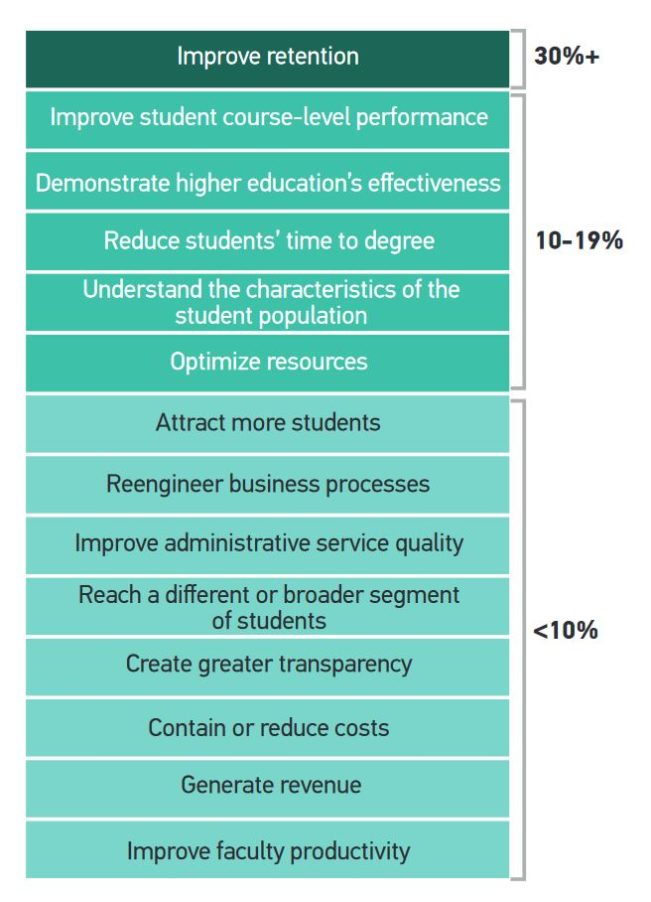
Learning
Analytics
Most Common Objectives

Slide 15
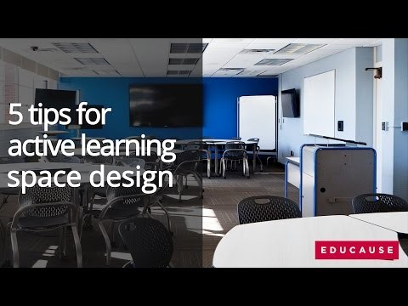
Learning Space Redesign
Mid-Term Trend: Three to five years
Video Link
Notes:
Vision (Technology vs Flexibility), Budget (last step, not the focus), Non-negotiables (Writing space, connectivity and power, flexible furniture) Real State (realistic, open, long-term sustainability),

Slide 16
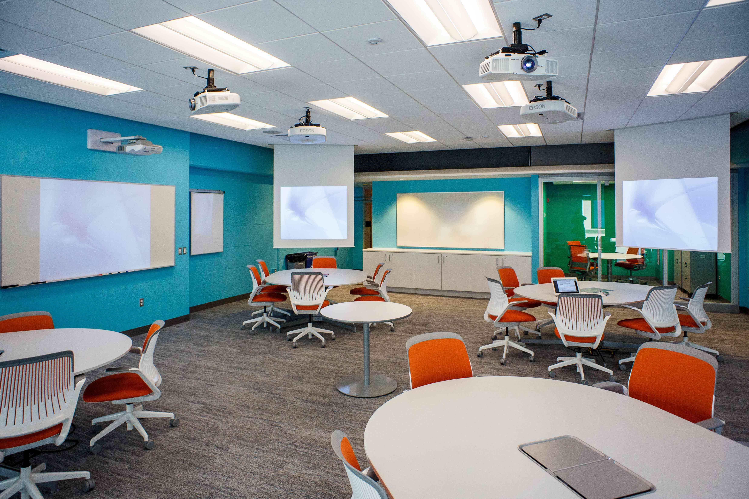
Notes:
Penn State

Slide 17
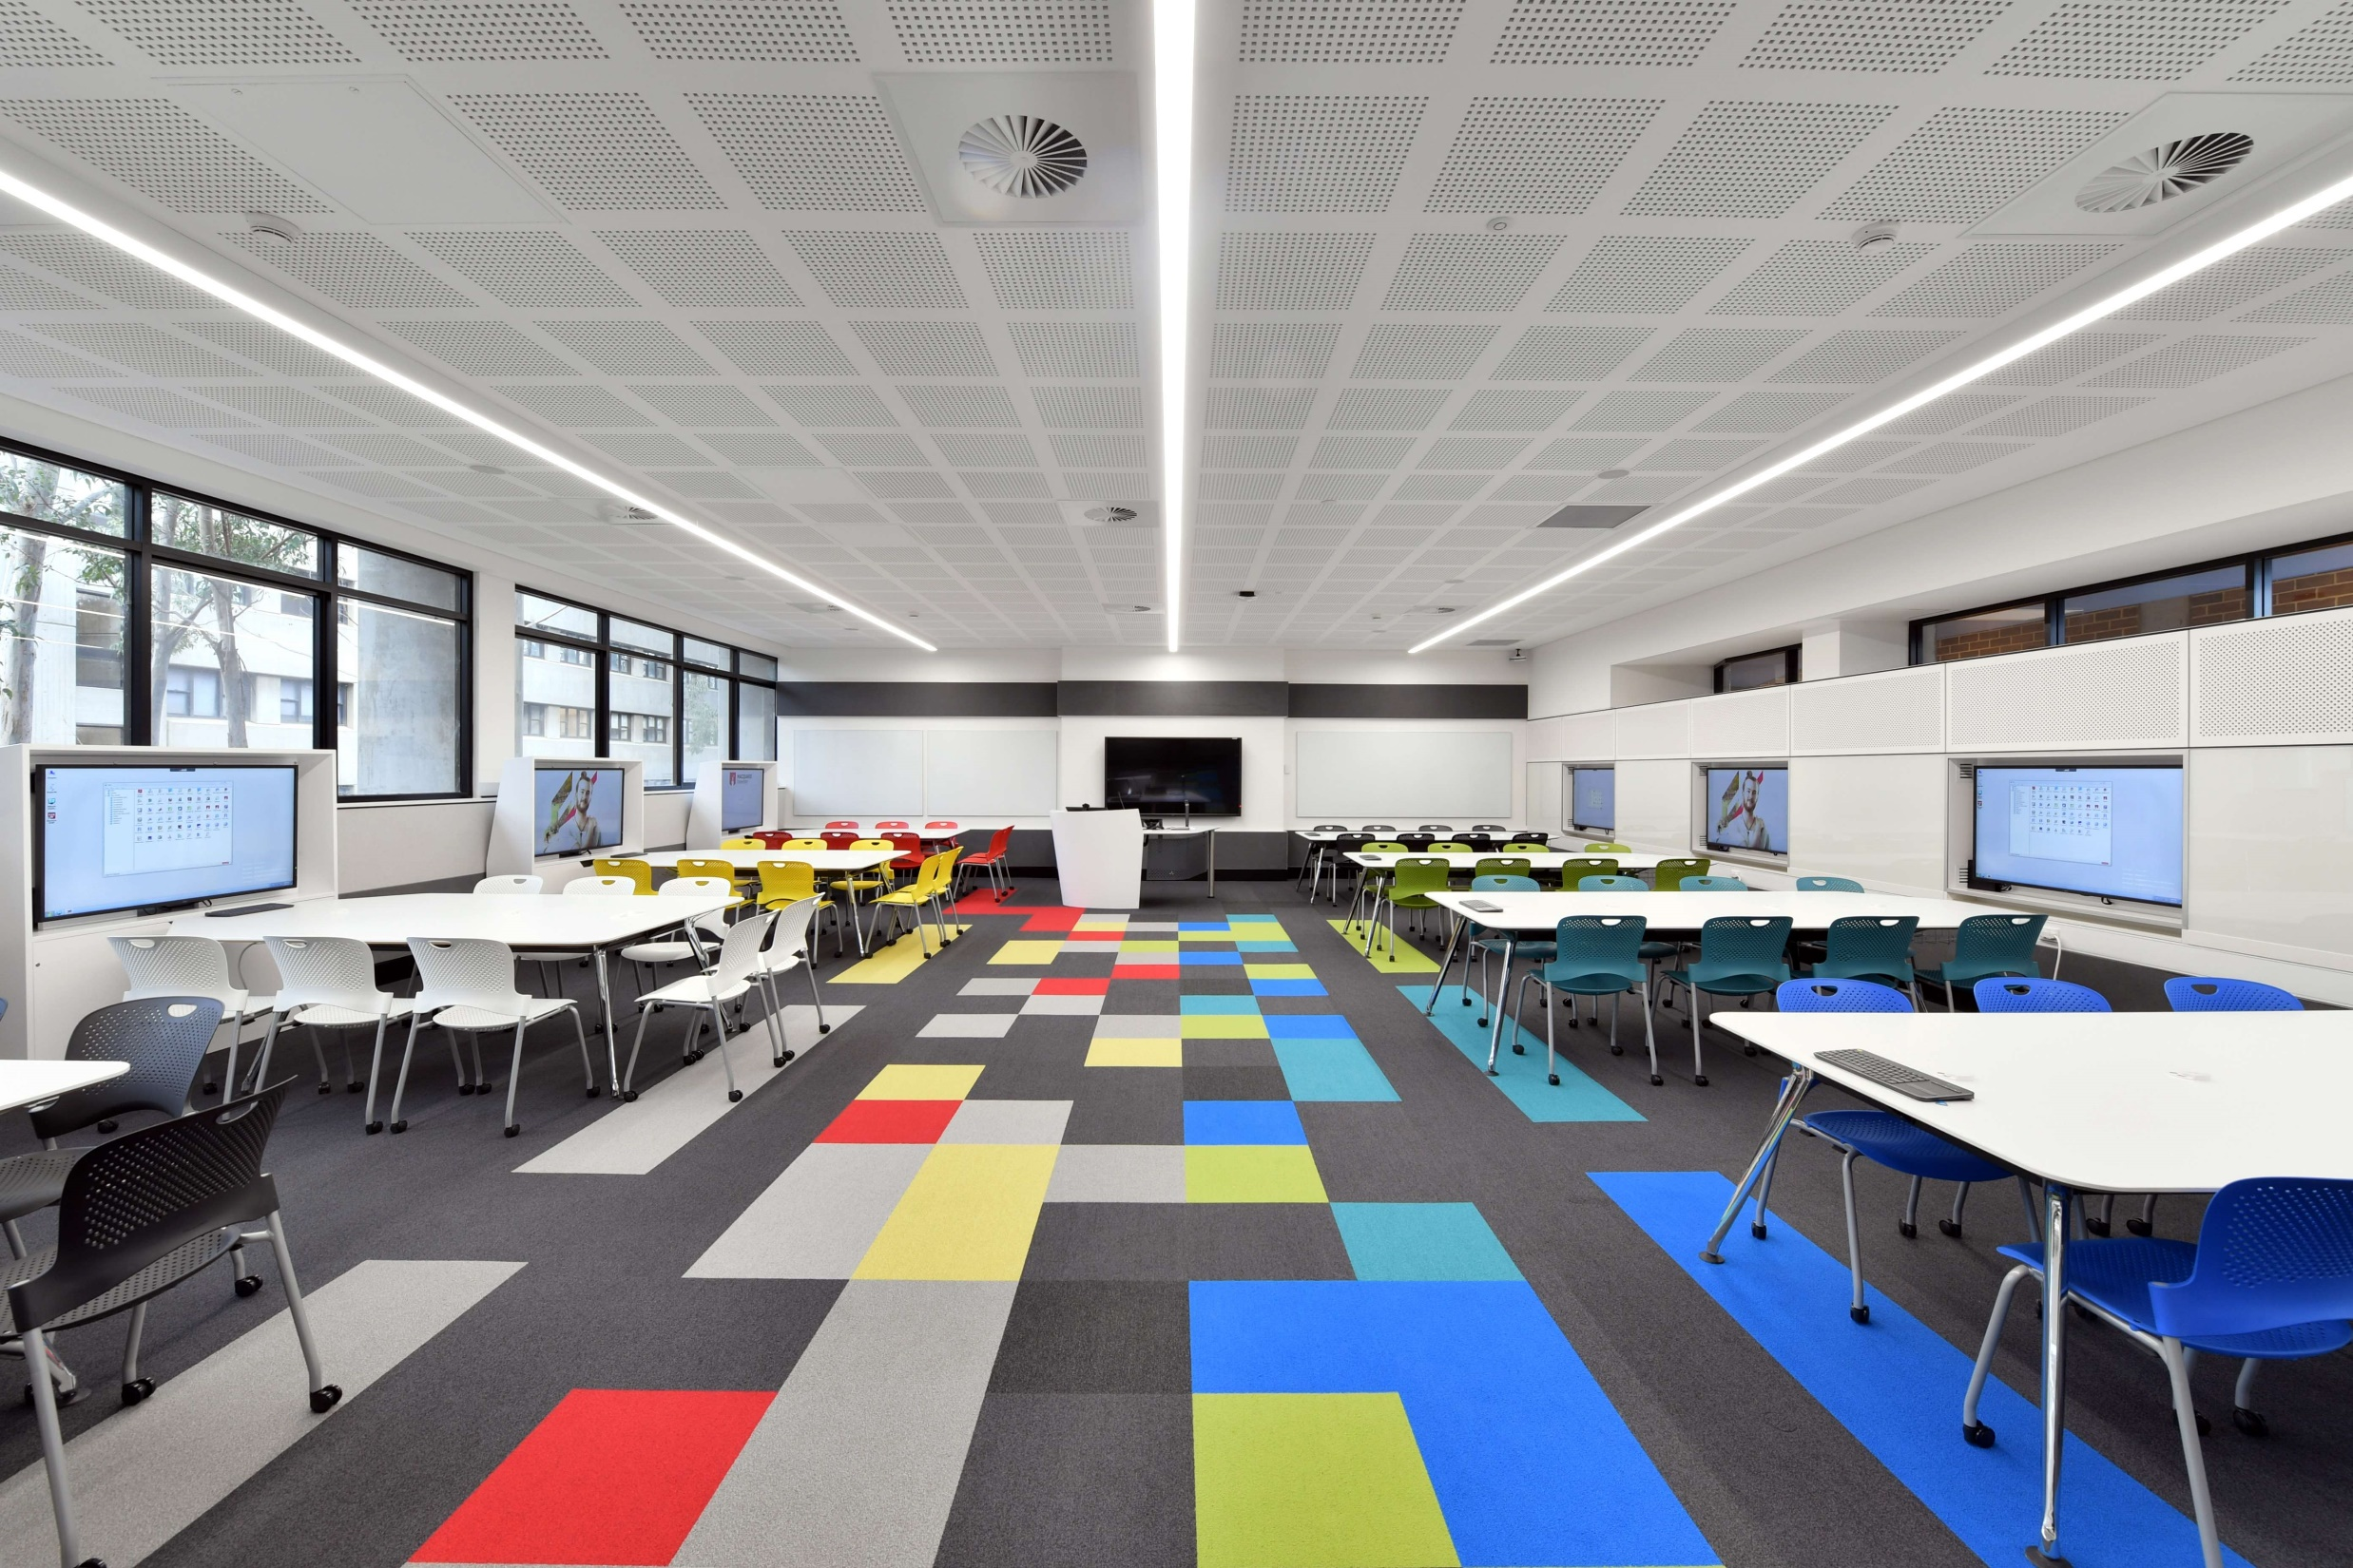
Notes:
Macquarie University is a public research university based in Sydney, Australia

Slide 18
Cultures of Innovation
Long-Term Trend: Five or more years
As campuses have evolved into hotbeds for entrepreneurship and discovery, higher education has become widely regarded as a vehicle for driving innovation.

Slide 19
Innovation in Higher Education - Insights
Research focusing on how institutions can promote experimentation.
Growing need to accept failure as an important part of the learning process.
Institutions must implement changes to remove barriers that limit the development of new ideas.
Notes:
Students’ innovation-friendly behaviors, such as curiosity and creativity, stem from the establishment of positive internal and external factors such as teamwork, support, and motivation.

Slide 20
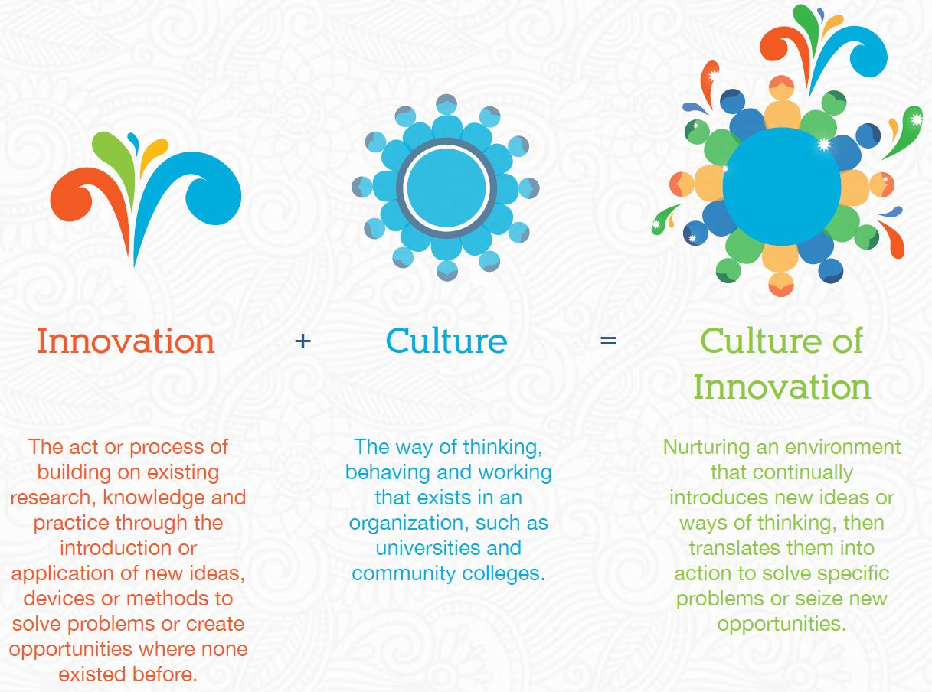

Slide 21
Internet of Things (IoT)
Time-to-Adoption Horizon: Two to Three Years
Everyday objects and small devices endowed with enough computing power to capture, process, and transmit information across networks.

Slide 22
IoT Insights
Many people are already familiar with IoT through their experiences with wearables (Apple Watch, Fitbit fitness tracker) and smart home products (Amazon Echo).
By 2020, nearly 21 billion connected “things” will be in use.
Global spending on IoT will reach $1.29 trillion by 2020.
Growing trend: smart city/campus (using ubiquitous connected devices to improve public/student services).

Slide 23
Acknowledgments
Marsha Kiner, Associate Executive Director, AFC
Sandi Barret, 2017 Director, AFC Region V
Jason Cohen, 2017 President, AFC Broward College Chapter
Jim Lansing, Legislative Representative, AFC Broward College Chapter

Slide 24
References
Adams Becker, S., Cummins, M., Davis, A., Freeman, A., Hall
Giesinger, C., and Ananthanarayanan, V. (2017). NMC Horizon
Report: 2017 Higher Education Edition. Austin, Texas: The New
Media Consortium.
Arroway, Pam, Glenda Morgan, Molly O’Keefe, and Ronald
Yanosky. Learning Analytics in Higher Education. Research report.
Louisville, CO: ECAR, March 2016.

