Slide 1
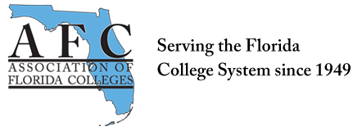
AFC West Campus Convocation
Friday, August 25
1:30 pm
Room 1120

Slide 2
MDC AFC OFFICERS
Miami Dade College Chapter Association of Florida Colleges 2017 Executive Board Officers Elected
Chapter President – Mark L. Johnson Chapter Secretary – Carol Wynter
Chapter Membership Chair
Daniella G. Pierre

Slide 3
Campus Officers
West Campus
Campus VP - Bertha Cabrera
Secretary - Dr. Chantelle Macphee Membership Chair - Professor Jesse Carlo Treasurer - Ericka Balladares

Slide 4
Why Join AFC
﻿Are you a Florida college employee who longs to grow? AFC-The Association of Florida Colleges really wants to know. We have 28 Florida State Colleges from Pensacola to Key West With 8,000 plus members, and our members are the best! Join us for learning, networking, and collaborations, Through the latest workshops, seminars, and conventions. Active members are entitled to awards and recognitions; Special discounts and privileges are part of your admission. We have various commissions to suit every interest and population, From student development, careers, equity, and administration, To institutional effectiveness, technology, and instructional innovation. We have a place where you will fit in And all you have to do is JOIN us to begin: Go to myafchome.org/JOIN-afc today And trust us that you will be here to stay! We advocate for funding to improve higher education. Our voice is strong, but add just one, and we can change the nation!

Slide 5
AFC Goals for 2017
Increase Chapter Membership by Ten Percent
Establish and Open Communication channel with MDC’s College President and Administrative Team
Advocacy Efforts–Support the MDC Legislative Agenda College-wide
Develop a Comprehensive Operational Plan to Include AFC’s Mission : Advocacy, Professional Development, Networking, and Community Service
Increase Active Involvement of AFC in Region V and at the State Level
Seek Opportunities for Fundraising to Support the Representation of MDC at AFC Annual Conferences, Convocation and Meetings

Slide 6
AFC MDC West
Visit us at http://afcmdc.weebly.com
SharePoint https://sharepoint.mdc.edu/north/committees/facc/SitePages/Home.aspx

