Slide 1
Open your sandbox-)select Control Panel -) Course Tools-)BB Collaboration Ultra

Slide 2
BB Collaborate Ultra Create Session with Join Course Room Phone # and Session’s link
https://tinyurl.com/wv8lxke

Slide 3
Sessions and recording under menu

Slide 4
The Welcome Room

Slide 5
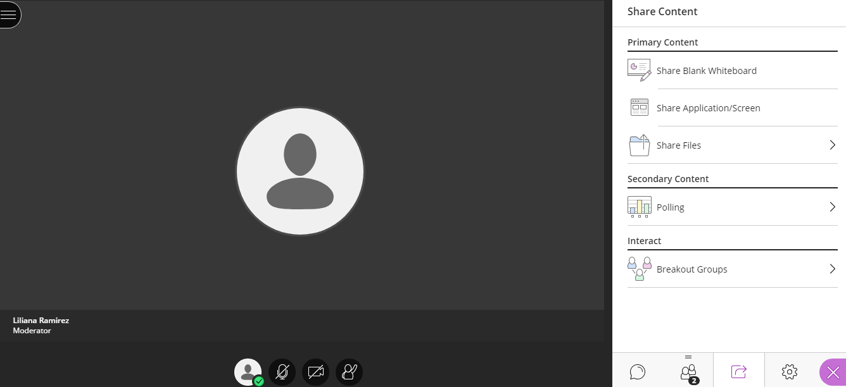
One participant joined

Slide 6
The Chat Room

Slide 7
Asking for help under the Chat room Menu

Slide 8
Share Content

Slide 9
The Share Blank Whiteboard selected

Slide 10
Share Application Room

Slide 11
Sharing files

Slide 12
Under My Settings

Slide 13
Sessions Report

Slide 14
Polling
2 participants Liliana Ramirez invited me on her polling.

Slide 15
Session options View reports

Slide 16
Video chat recorded session of the PP presentation for the students to revise

Slide 17
View of the recorded screen session

Slide 18
The end of the recorded session

Slide 19
Q&A
Reflection Questions:
1. How did your online session go? Describe the learning experience.
I like to chat and receive answers back and forward (no more emails).
2. Did you use the computer to join the meeting or a phone? Did you face any technical issues? I use the computer, however, I have used a phone in the past. I didn’t have any technical difficulty.
3. How do you plan on using this tool to support your users/students' learning? Please share at least 2 ideas. 1) to conduct registrations meetings using chat. 2) to share the files that deem appropriate for the students to look into the schedules and instructions.
4. How do you think this tool will benefit your students/users? Please share a few ideas. Sharing and collaborating with the students/faculty. Webinars on live chats, PDs, learning communities, circles.

